Slide 1
Neural Networks
Melissa Anthony and Micah Reid

Slide 3
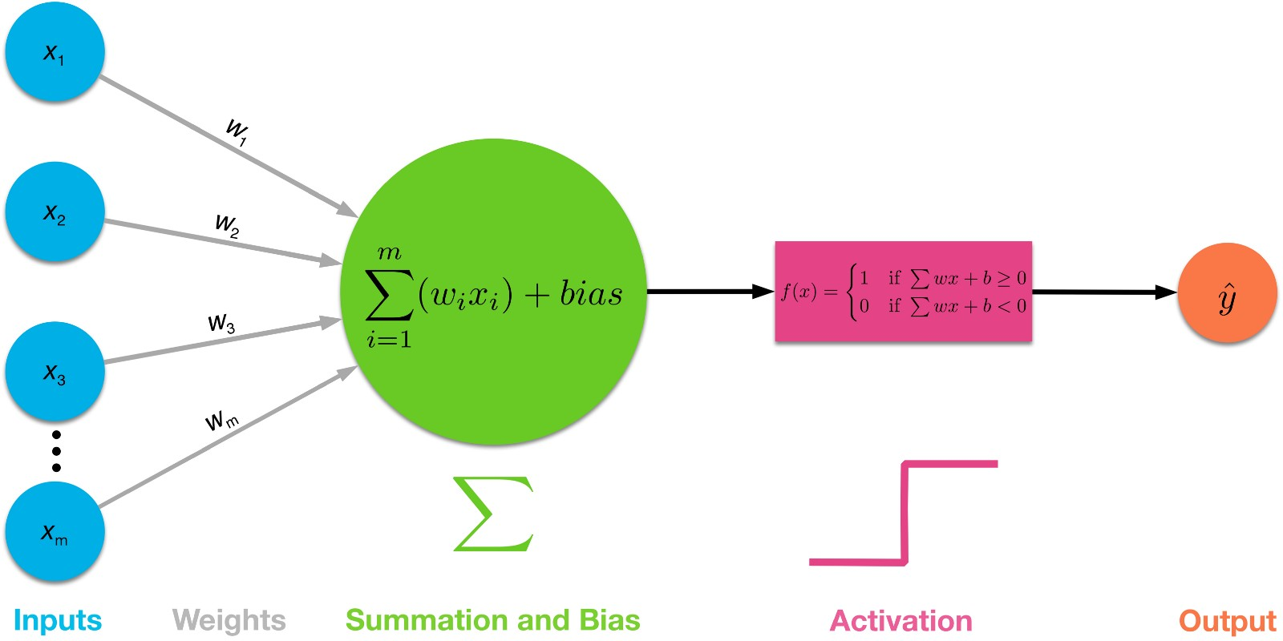

Slide 4
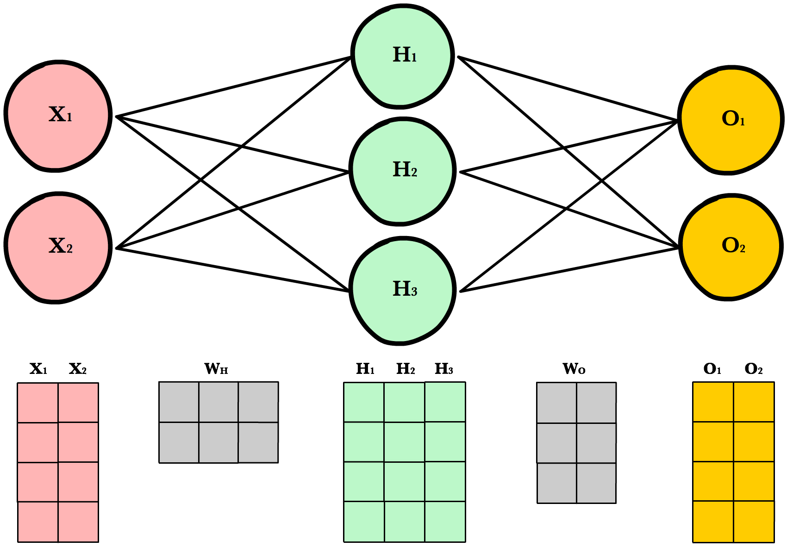

Slide 5
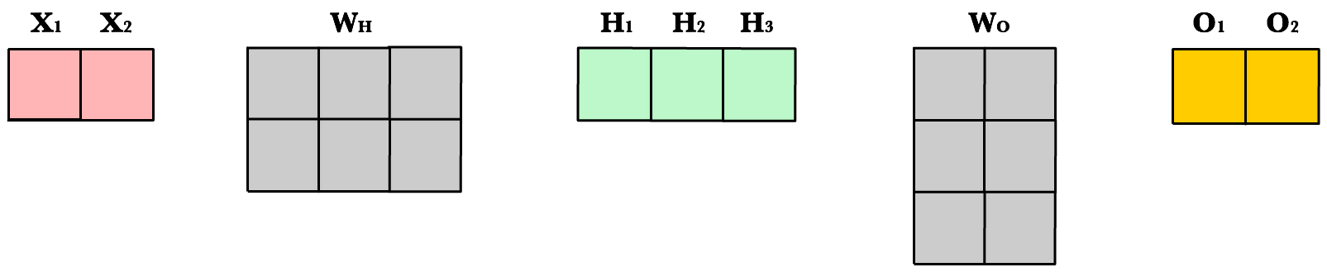

Slide 6
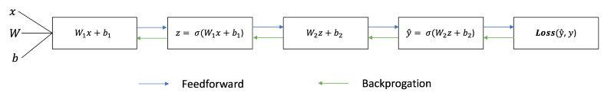

Slide 7

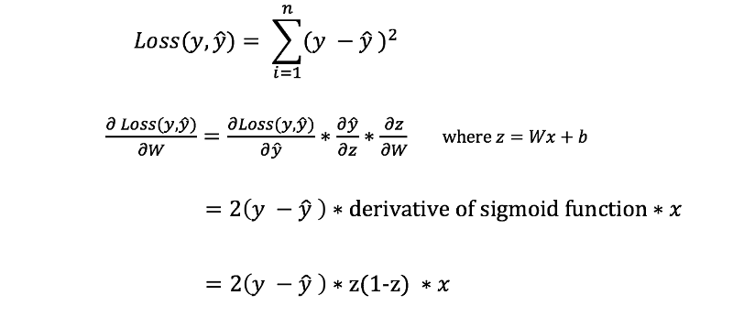

Slide 9
Results

Slide 10
Resources
Towardsdatascience.com article by James Loy:
https://towardsdatascience.com/how-to-build-your-own-neural-network-from-scratch-in-python-68998a08e4f6
FreeCodeCamp article by Daphne Cornelisse:
https://medium.freecodecamp.org/building-a-3-layer-neural-network-from-scratch-99239c4af5d3
Ava Lakmazaheri and Emily Lepert’s Linearity 2 Paper:
https://drive.google.com/file/d/1Z-xqGIVuRK9p1M4Qnov_orMx3R0ndbPq/view
3Blue1Brown Youtube Series on Neural Networks:
https://www.youtube.com/watch?v=aircAruvnKk
https://ml-cheatsheet.readthedocs.io/en/latest/forwardpropagation.html

